Slide 1
Overview of System analysis & Design (BIT270CO)
-By Sheetal (www.sheetal.com.np)

Slide 2
What will you learn
Introduction to system analysis and design
Information systems and its types
Stakeholders of information systems
Systems development life cycle and life cycle models (waterfall, spiral, prototype)
Introduction to CASE tools

Slide 3
Introduction to System Analysis & Design
Systems development is systematic process which includes phases such as planning, analysis, design, deployment, and maintenance.
It is a complex, challenging and stimulating organizational process that a team of business and system professionals use to develop and maintain computer-based information system
Organizational improvement process
An important (but not only) result of SAD is application software

Slide 4
Analysis vs Design
System Analysis
It is a process of collecting and interpreting facts, identifying the problems, and decomposition of a system into its components.
It is a problem solving technique that improves the system and ensures that all the components of the system work efficiently to accomplish their purpose.
Analysis specifies what the system should do.
System Design
It is a process of planning a new business system or replacing an existing system by defining its components or modules to satisfy the specific requirements.
System Design focuses on how to accomplish the objective of the system.

Slide 5
A Modern Approach to Systems Analysis and Design
1950s: focus on efficient automation of existing processes
1960s: advent of procedural third generation languages (3GL) faster and more reliable computers
1970s: system development becomes more like an engineering discipline
1980s: major breakthrough with 4GL, CASE tools, object-oriented methods
1990s: focus on system integration, GUI applications, client/server platforms, Internet
The new century: Web application development, wireless PDAs and smart phones, component-based applications, application service providers (ASP)
Notes:
)

Slide 6
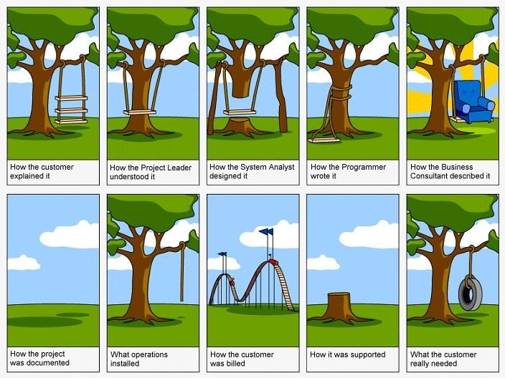

Slide 7
Information System and Its Type
A combination of hardware, software, infrastructure and trained personnel organized to facilitate planning, control, coordination, and decision making in an organization.
Types
Transaction processing systems
Management information systems
Decision support systems
Expert systems

Slide 8
Transaction Processing System
Transaction Processing System (TPS) automate the handling of data about business activities or transactions, which can be thought of as simple, discrete event in the life of organization.
Data about each transaction are captured, transactions are verified and accepted or rejected and validated transactions are stored for latter use.
The following features are considered important in evaluating transaction processing systems.
Performance, continuous availability, Data integrity, Ease of Use, Modular growth

Slide 9
Management Information System
A management information aka MIS takes the relatively raw data available through a TPS and convers them into a meaningful aggregated form that managers need to conduct their responsibility
Developing an MIS calls for a good understanding of what kind of information managers require and how managers use information in their jobs.
MIS often require data from several TPS

Slide 10
Decision Support System
Decision Support Systems aka DSS are designed to help organizational decision makers to make decisions.
Instead of providing summaries of data, as with an MIS, a DSS provides an interactive environment in which decision makers can quickly manipulate data and models of business operation
A DSS is composed of a database (extracted from a TPS or MIS), mathematical or graphical models of business process, and a user interface that provides a way for the decision makers

Slide 11
Expert System
An Expert system attempts to manipulate knowledge rather than information
An expert system is a computer system that emulates the decision-making ability of a human expert.
Expert systems are designed to solve complex problems by reasoning through bodies of knowledge, represented mainly as if–then rules
Expert systems were among the first truly successful forms of artificial intelligence (AI) software.

Slide 12
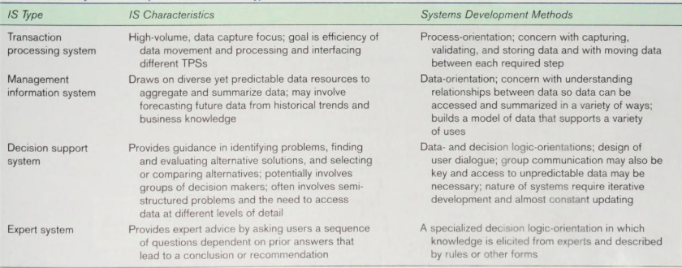
Comparison of Different Systems

Slide 13
Separating Data and Process that handles data
Every IS consists of three components
Data
Data flow
Processing logic
Data are raw fact that describe people, objects and event in an organization
Data flows are groups of data that move and flow through a systwwm and includes a description of the source and destination
Processing logic describes the steps in transformation of the data

Slide 14
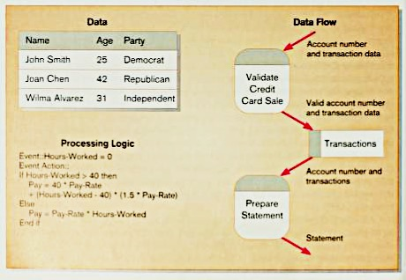
Data vs Data flow vs Processing logic

Slide 15
Stakeholders of information systems
A person who has an interest in an existing or new IS
Major Stakeholder are
IS Manager
System Analysts
Programmer
Business Managers
Other IS Manager and Technicians

Slide 16
IS manager
IS manager are involved in allocating resources rather than actual development process
Oversees approved system development process
Should attend review meeting and maintain status report
May prescribe methodologies, technique and tools

Slide 17
Systems Analysts
A systems analyst is an IT professional who specializes in analyzing, designing and implementing information systems.
Needs four skills
Analytical Skills – skills enable to understand the organization and its function
Technical skills – skills help to understand the potential and the limitation of IT
Management skills – skills help to manage project, resources, risk and change
Interpersonal skills – skills help to work with end users as well as with other analysts and programmer

Slide 18
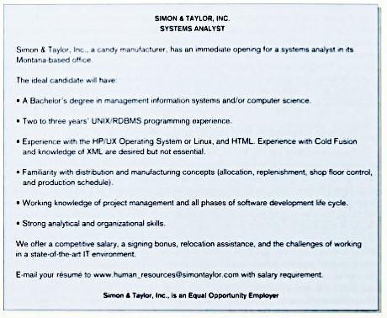

Slide 19
Programmers
Programmers convert the system specifications given to them by the analysts into instruction the computer can understand
Also writes program documentation and program for testing system
Previously considered as an art but now code is improved as structural programming
In structural programming, all computing instructions can be represented through the use of three simple structure : sequence, repetition and selection
Very labor-intensive job

Slide 20
Business managers
Business managers are functional department heads and corporate executives
They have power to fund development project and to allocate the resources necessary for the projects
They are able to set general requirement and constraints for development project
They set direction for system development, propose and approve projects, determine relative importance of projects and assign to other people in organization

Slide 22
System Development Life Cycle
System Development Life Cycle aka SDLC is a common methodology for system development in many organizations, featuring several phases that mark the progress of the systems analysis and design effort
Number of phases depends on author to author from three to twenty identifiable phase

Slide 23
Phases in SDLC
Phases in SDLC:
Planning
Analysis
Design
Implementation
Maintenance

Slide 24
Systems Development Life Cycle (SDLC) (Cont.)
Planning – an organization’s total information system needs are identified, analyzed, prioritized, and arranged
Analysis – system requirements are studied and structured
Design – a description of the recommended solution is converted into logical and then physical system specifications
Logical design – all functional features of the system chosen for development in analysis are described independently of any computer platform
Physical design – the logical specifications of the system from logical design are transformed into the technology-specific details from which all programming and system construction can be accomplished

Slide 25
Systems Development Life Cycle (SDLC) (Cont.)
Implementation – the information system is coded, tested, installed and supported in the organization
Maintenance – an information system is systematically repaired and improved

Slide 26
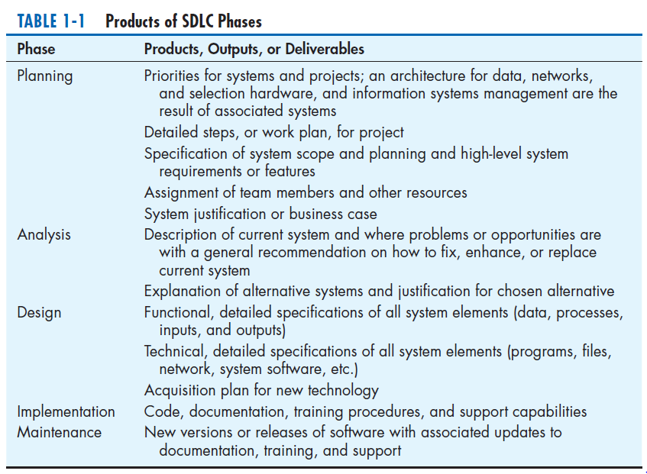

Slide 28
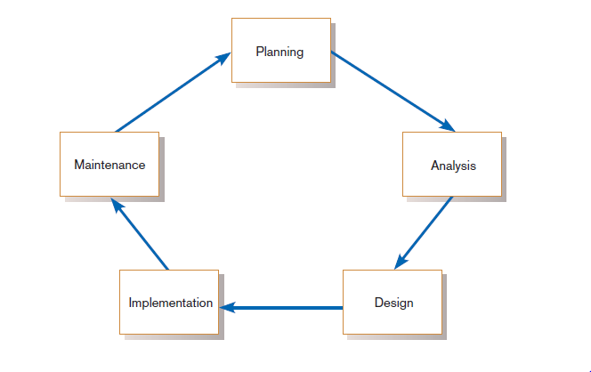
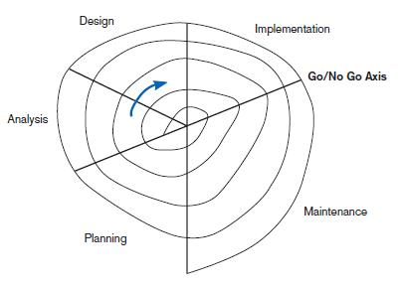
Standard and Evolutionary Views of SDLC
FIGURE 1-3 Evolutionary model
FIGURE 1-2
Systems development life cycle

Slide 29
Waterfall Model
Waterfall model is a relatively linear sequential design
This structured approach looks at the system from a top-down view.
It is a formalized step by step approach to the systems development lifecycle (SDLC) which consists of phases or activities. T
The activities of one phase must be completed before moving to the next phase. At the completion of each activity or phase, a milestone has been reached and a document is produced to be approved by the stakeholders before moving to next phase

Slide 31
Advantage of waterfall model
This model is simple and easy to understand and use.
It is easy to manage due to the rigidity of the model – each phase has specific deliverables and a review process.
In this model phases are processed and completed one at a time. Phases do not overlap.
Waterfall model works well for smaller projects where requirements are clearly defined and very well understood.

Slide 32
Disadvantages of Waterfall Model
Once an application is in the testing stage, it is very difficult to go back and change something that was not well-thought out in the concept stage.
No working software is produced until late during the life cycle.
High amounts of risk and uncertainty.
Not a good model for complex and object-oriented projects.
Poor model for long and ongoing projects.
Not suitable for the projects where requirements are at a moderate to high risk of changing.

Slide 33
When to use waterfall model
This model is used only when the requirements are very well known, clear and fixed.
Product definition is stable.
Technology is understood.
There are no ambiguous requirements
Ample resources with required expertise are available freely
The project is short.

Slide 34
Spiral Model
The spiral model is a risk-driven software development process model.
The spiral model has four phases: Planning, Risk Analysis, Engineering and Evaluation.
Planning Phase: Requirements are gathered during the planning phase.
Risk Analysis: In the risk analysis phase, a process is undertaken to identify risk and alternate solutions. A prototype is produced at the end of the risk analysis phase. If any risk is found during the risk analysis then alternate solutions are suggested and implemented.
Engineering Phase: In this phase software is developed, along with testing at the end of the phase. Hence in this phase the development and testing is done.
Evaluation phase: This phase allows the customer to evaluate the output of the project to date before the project continues to the next spiral.

Slide 36
Advantages of Spiral model
High amount of risk analysis hence, avoidance of Risk is enhanced.
Good for large and mission-critical projects.
Strong approval and documentation control.
Additional Functionality can be added at a later date.
Software is produced early in the Software Life Cycle

Slide 37
Disadvantages of Spiral model
Can be a costly model to use.
Risk analysis requires highly specific expertise.
Project’s success is highly dependent on the risk analysis phase.
Doesn’t work well for smaller projects.

Slide 38
When to use Spiral model:
When costs and risk evaluation is important
For medium to high-risk projects
Long-term project commitment unwise because of potential changes to economic priorities
Users are unsure of their needs
Requirements are complex
New product line
Significant changes are expected (research and exploration)

Slide 39
Prototype Model
The basic idea in Prototype model is that instead of freezing the requirements before a design or coding can proceed, a throwaway prototype is built to understand the requirements.
This prototype is developed based on the currently known requirements.
By using this prototype, the client can get an “actual feel” of the system, since the interactions with prototype can enable the client to better understand the requirements of the desired system.
Prototyping is an attractive idea for complicated and large systems for which there is no manual process or existing system to help determining the requirements.

Slide 41
Advantages of Prototype model
Users are actively involved in the development
Since in this methodology a working model of the system is provided, the users get a better understanding of the system being developed.
Errors can be detected much earlier.
Quicker user feedback is available leading to better solutions.
Missing functionality can be identified easily
Confusing or difficult functions can be identified

Slide 42
Disadvantages of Prototype model:
Leads to implementing and then repairing way of building systems.
Practically, this methodology may increase the complexity of the system as scope of the system may expand beyond original plans.

Slide 43
When to use Prototype model
Prototype model should be used when the desired system needs to have a lot of interaction with the end users.
Typically, online systems, web interfaces have a very high amount of interaction with end users, are best suited for Prototype model. It might take a while for a system to be built that allows ease of use and needs minimal training for the end user.
Prototyping ensures that the end users constantly work with the system and provide a feedback which is incorporated in the prototype to result in a useable system. They are excellent for designing good human computer interface systems.

Slide 44
CASE Tools
Computer-Aided Software Engineering tools
Software Tools that provide automated support for some portion of the system development process
CASE tools are used to support a wide variety of SDLC activities
Can be used to help in the project identification and selection, project initiation and planning, analysis, design, implementation and maintenance
Examples: Series of IBM Rational tools, Argo UML, GNU debugger, SCCS (source code control system, track the change in source code)

Slide 45
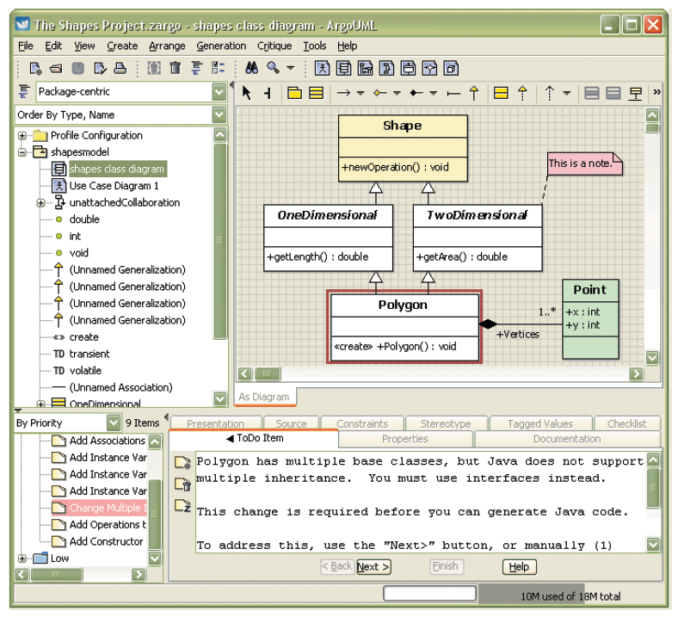
CASE Tools (Cont.)
FIGURE 1-11
Screen shot of ArgoUML, an open source CASE tool
(Source: http://argouml.tigris.org/)

Slide 46
General Types of CASE tools
Diagramming tools enable graphical representation.
Computer displays and report generators help prototype how systems “look and feel”.
Analysis tools automatically check for consistency in diagrams, forms, and reports.
A central repository provides integrated storage of diagrams, reports, and project management specifications.
Documentation generators standardize technical and user documentation.
Code generators enable automatic generation of programs and database code directly from design documents, diagrams, forms, and reports.

Slide 47
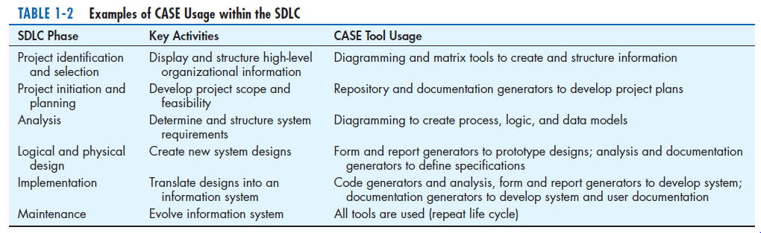
CASE Tools (Cont.)

Slide 48
Rapid Application Development (RAD)
Decreases design and implementation time
Involves: extensive user involvement, prototyping, integrated CASE tools, code generators
More focus on user interface and system function, less on detailed business analysis and system performance

Slide 49
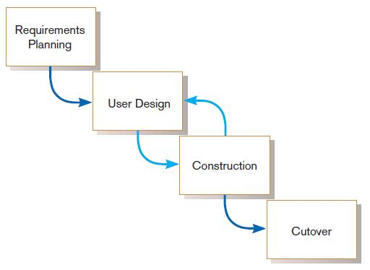
Rapid Application Development (RAD) (Cont.)
FIGURE 1-12
RAD life cycle

Slide 50
References
Modern System Analysis and Design - Pearson
www.tryqa.com
https://www.tutorialspoint.com/system_analysis_and_design/

